Slide 1
Install SQL 2017 Server
Step by step installation guide
Dragos Rosca
Automatica si Calculatoare 2018

Slide 2
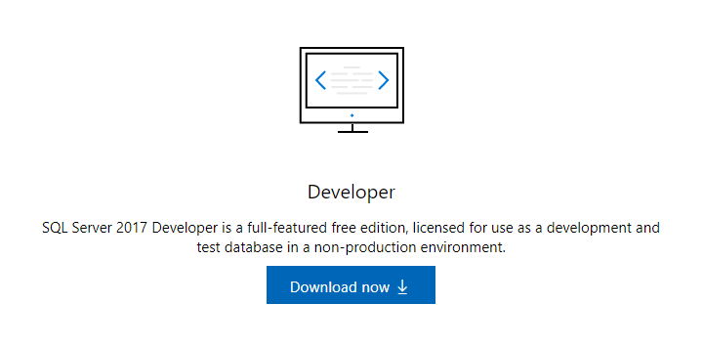
Download
Go to https://www.microsoft.com/en-us/sql-server/sql-server-downloads
Scroll to “Or, download a free specialized edition”
Click “Download Now”

Slide 3
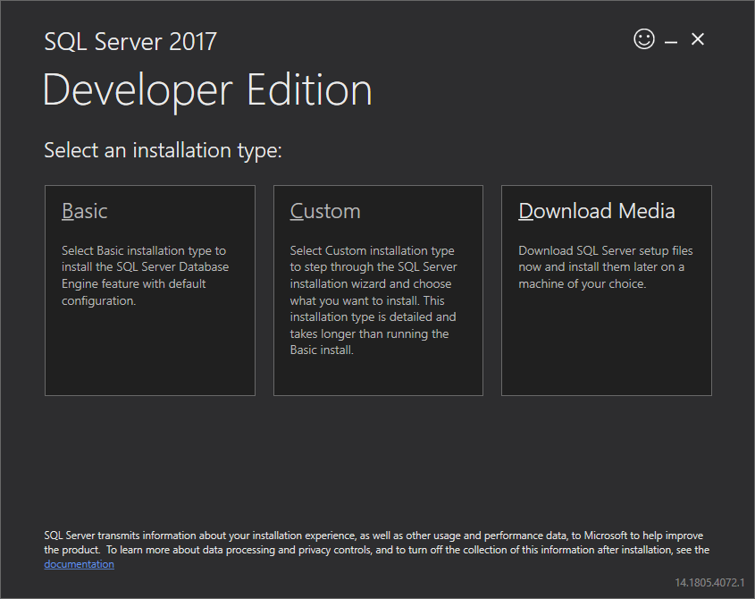
Run Installer
Double click “SQLServer2017-SSEI-Dev.exe” and give it Administrator rights if asked
Choose installation type “Basic”

Slide 4
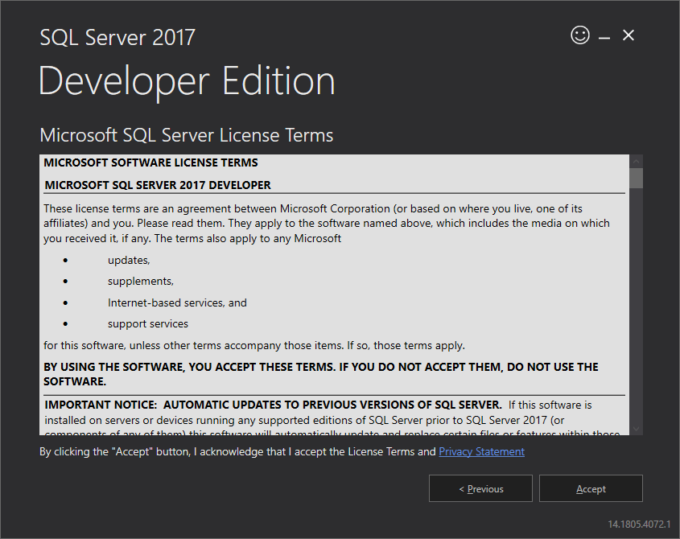
Run Installer
Accept license terms

Slide 5
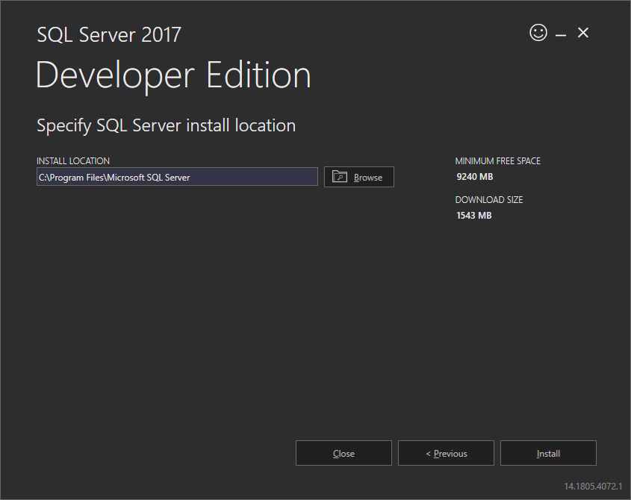
Run Installer
If you want, change the installation location
Proceed to click “Install”

Slide 6
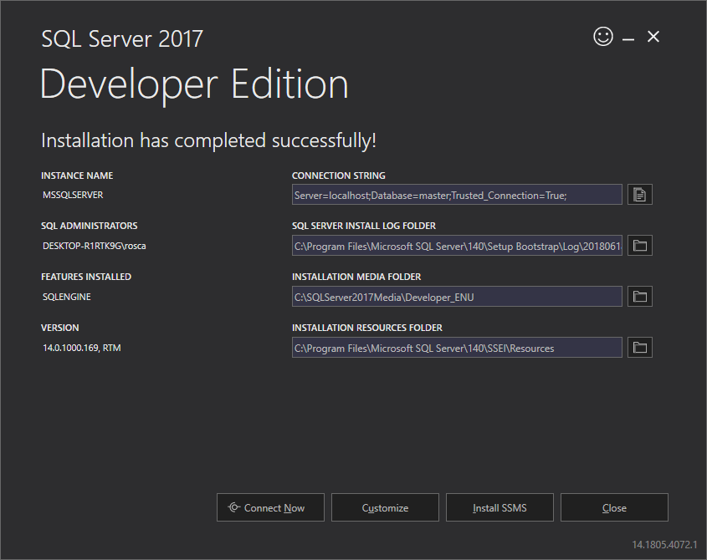
Run Installer
Click “Install SSMS” (SQL Server Management Studio)

Slide 7
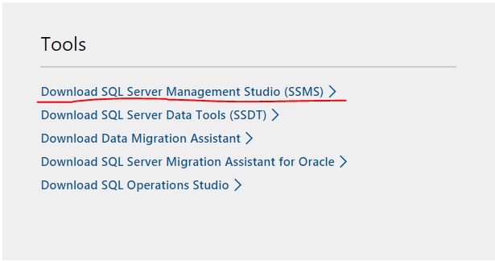
If on the previous Slide you clicked close
Go back to https://www.microsoft.com/en-us/sql-server/sql-server-downloads
Scroll further down to “SQL Server tools and connectors”
Click “Download SQL Server Management Studio (SSMS)”

Slide 8

Download
On the new page https://docs.microsoft.com/en-us/sql/ssms/download-sql-server-management-studio-ssms?view=sql-server-2017
Click “Download SQL Server Management Studio 17.7”

Slide 9
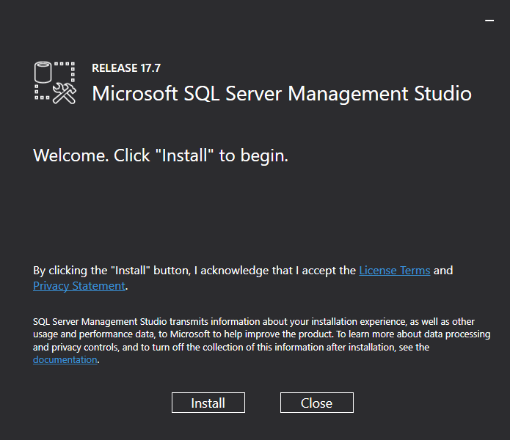
Run Installer
Double click “SSMS-Setup-ENU.exe” and give it Administrator rights if asked
Click “Install”

Slide 10
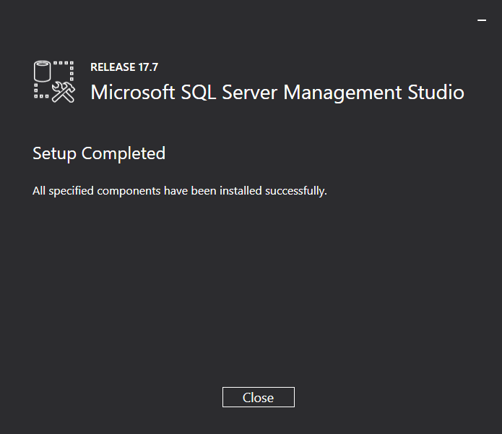
Run Installer
Click “Close”

Slide 11
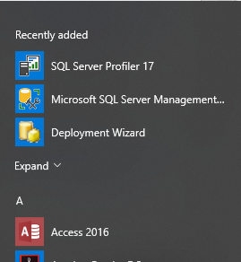
Test installation
Press Window Key and open “Microsoft SQL Server Management Studio 17”
You can find it in “Recently added”
Or scroll down to “M”
Expand “Microsoft SQL Server Tools 17”

Slide 12
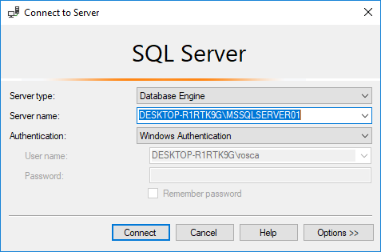
Test installation
Click “Connect”

Slide 13
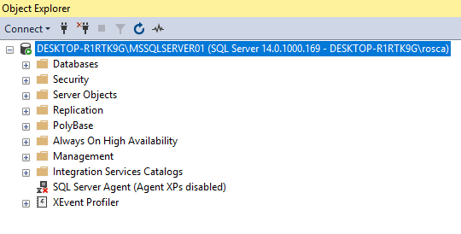
Test installation
You should see something like this

Slide 14
SQL Server Is Installed
Congratulation!
Automatica si Calculatoare 2018

